Slide 1
Physical holdings advanced search
Yoel Kortick
Senior Librarian

Slide 2

Agenda
Introduction
Physical holdings advanced search
Physical holdings advanced search results

Slide 3
Introduction
3

Slide 4
Introduction
In this presentation we will discuss:
  The physical holdings advanced search
  The physical holdings advanced search results

Slide 5
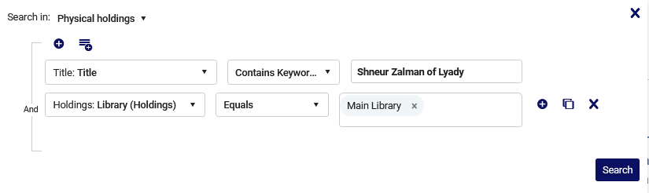
Introduction
The physical holdings advanced search

Slide 6
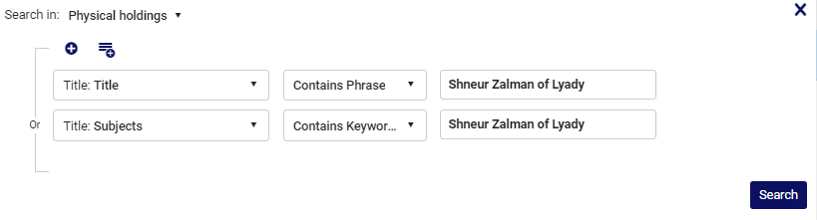
Introduction
On the top of the advanced physical holdings search we have two parts:
Add rule
Add group
We will show examples of both
Add rule
Add group

Slide 7
Physical holdings advanced search
7

Slide 8
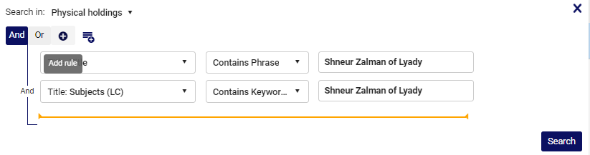
Physical holdings advanced search
The “Add Rule” “Plus” icon adds a condition
Here we have added a condition: Subjects (LC) contains keywords “Shneur Zalman of Lyady”

Slide 9
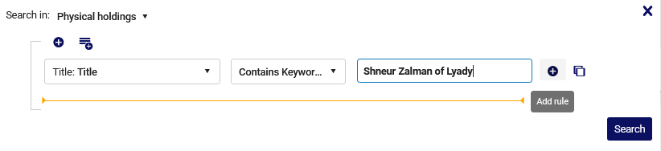
Physical holdings advanced search
Note that it is also possible to add a rule via the plus sign at the end of the search field:

Slide 10
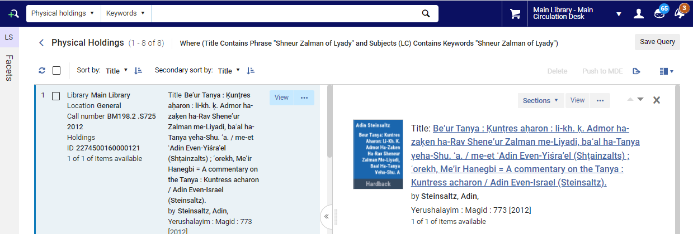
Physical holdings advanced search
After clicking “Search” we see that we have 8 results

Slide 11
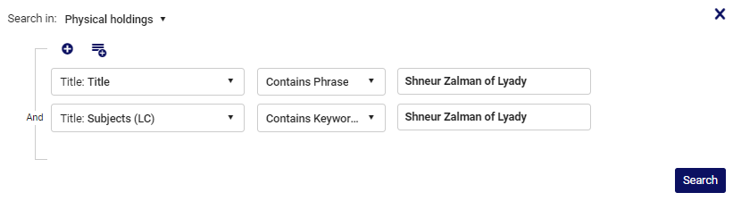
Physical holdings advanced search
If we click the “And” Boolean operator …

Slide 12
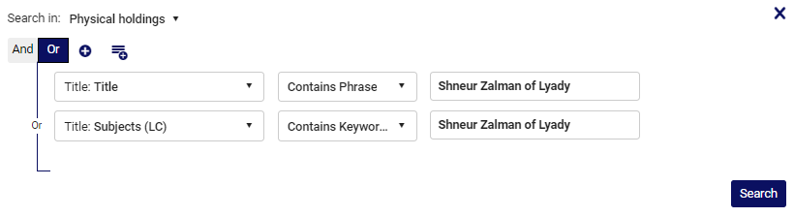
Physical holdings advanced search
Then we can change the operator to “Or” (and vice versa)

Slide 13
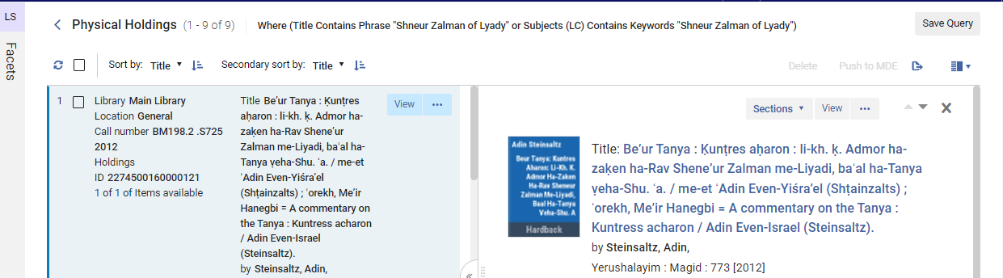
Physical holdings advanced search
Searching with “Or” gives us 9 results (which means one of the records has “Shneur Zalman of Lyady” in the title or subject but not both, because we had 8 results with “and”)

Slide 14
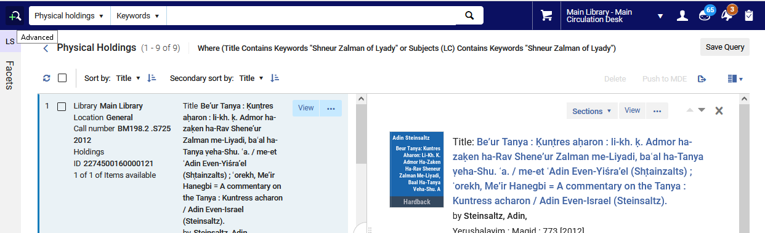
Physical holdings advanced search
When we click the Advanced Search link from the results, we return to the last search which was done
We will now click here

Slide 15
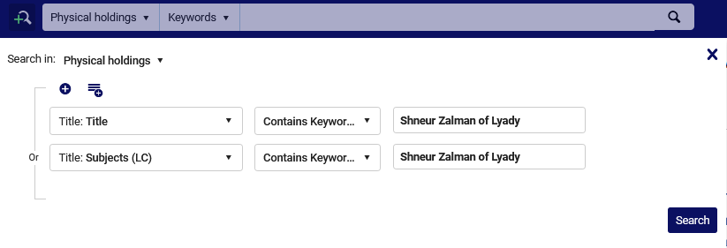
Physical holdings advanced search
We have now returned to our previous search query

Slide 16
Physical holdings advanced search
We will now show how to use a “group”, which can function as a “search within a search”.
Our goal here will be to get everything which has “Shneur Zalman of Lyady” in the bibliographic title, and either “sheep” or “calf” in the binding note.
First we will do the title search, and then add a “group”. The group will be “Holdings Binding note contains keywords “sheep” or “Holdings Binding note contains keywords “calf”

Slide 17
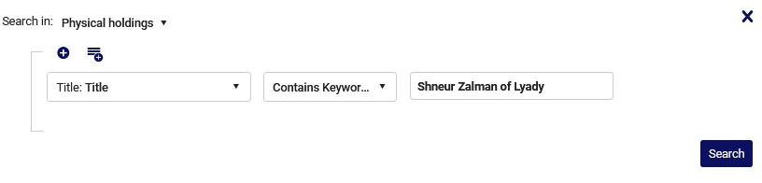
Physical holdings advanced search
We will now add the group
Click here to add the group

Slide 18
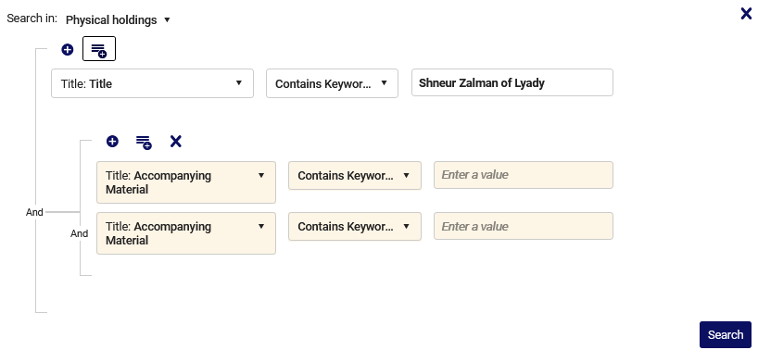
Physical holdings advanced search
The group got added and now we will choose desired fields, values and operator in the group.
This is the group

Slide 19
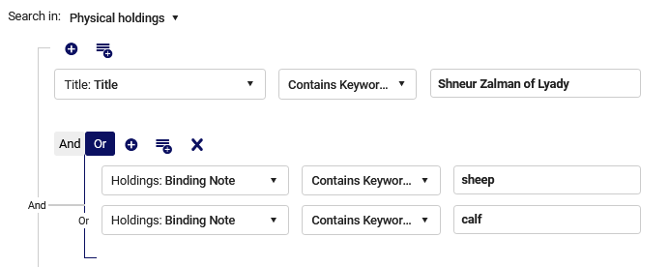
Physical holdings advanced search
Now we have our desired search: everything which has “Shneur Zalman of Lyady” in the bibliographic title, and either “sheep” or “calf” in the binding note.

Slide 20
Physical holdings advanced search
We see from the results that we have a “nested” Boolean search (a Boolean search inside a Boolean search):
Where (Title Contains Keywords "Shneur Zalman of Lyady" and (Binding Note Contains Keywords "sheep" or Binding Note Contains Keywords "calf"))

Slide 21
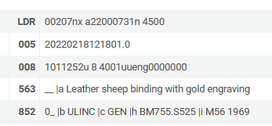
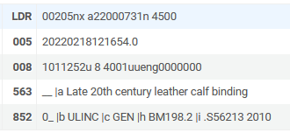
Physical holdings advanced search
Both holdings records have either “sheep” or “calf” in the binding note.

Slide 22
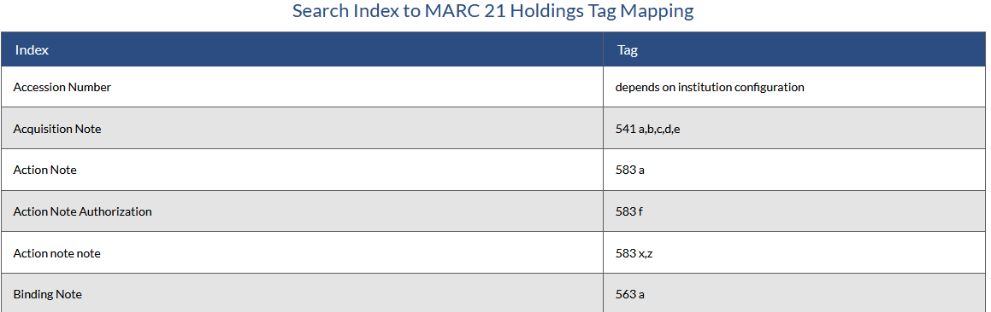
Physical holdings advanced search
We can see in the list of MARC21 indexes that the binding note comes from the holdings record field 563:.

Slide 23
Physical holdings advanced search
Now we will do an example where we combine bibliographic and holdings information without using a “group”.
We will search for all records where all of the following conditions exist:
  Bibliographic titles contains phrase “Shneur Zalman of Lyady”:
  Holdings permanent call number type = Library of Congress classification
  Holdings permanent call number contains keywords BM755

Slide 24
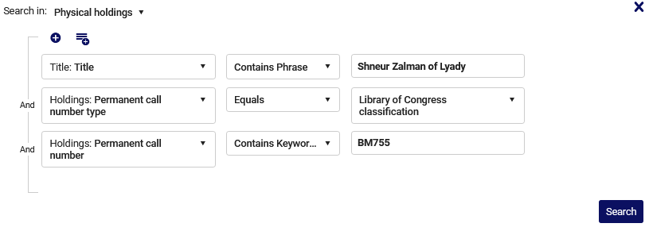
Physical holdings advanced search
Here is the search

Slide 25
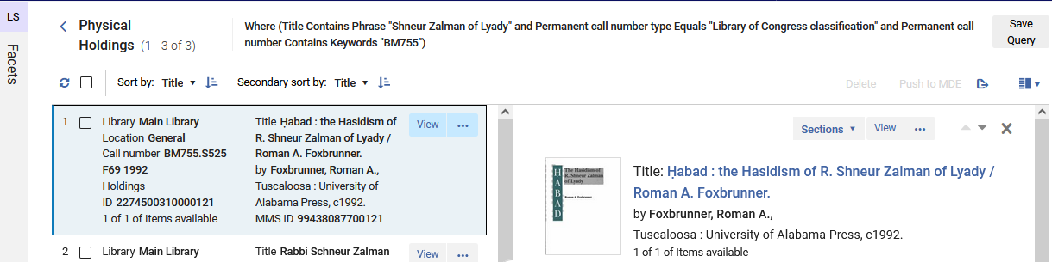
Physical holdings advanced search
The (beginning of the) results

Slide 26
Physical holdings advanced search results
26

Slide 27
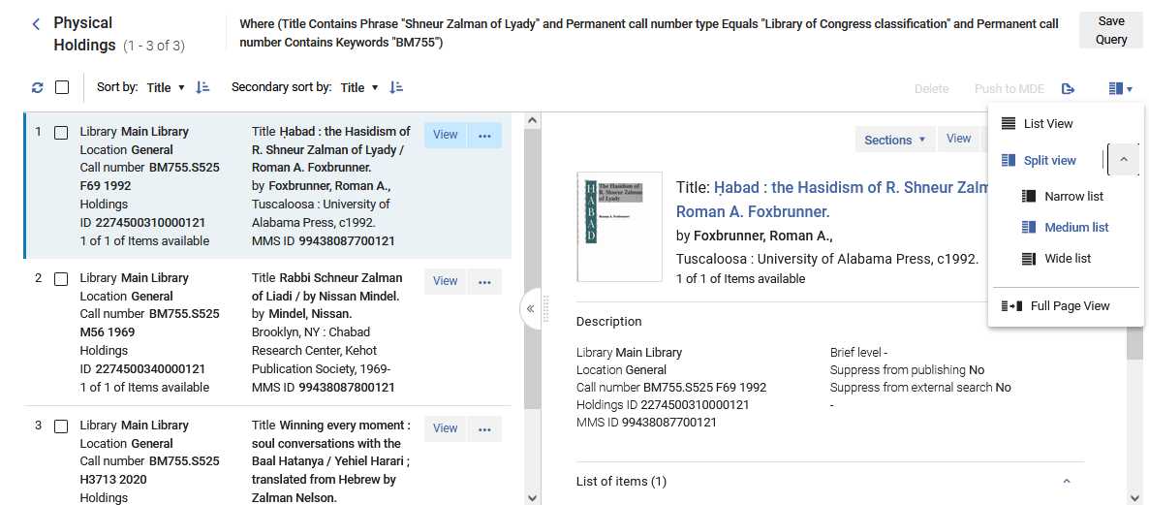
Physical holdings advanced search results
The view we see here is called “Split View” and it is in resolution “medium”
The staff user can choose his or her desired view

Slide 28
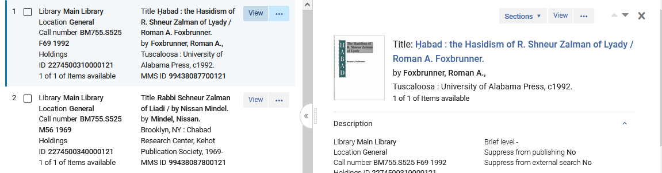
Physical holdings advanced search results
If we click “View” for a holdings record in the left pane …

Slide 29
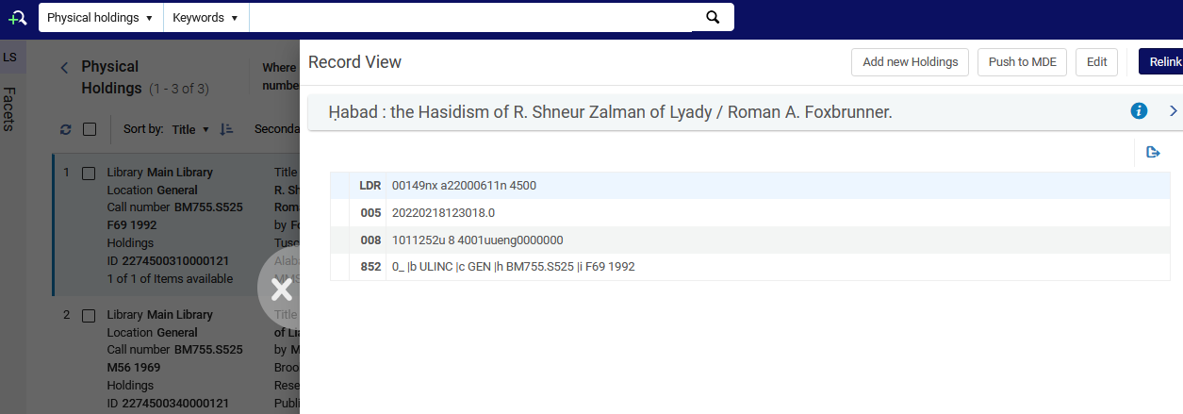
Physical holdings advanced search results
Then the holdings record will “slide out” from the right
Additional actions may be performed on the holdings record

Slide 30
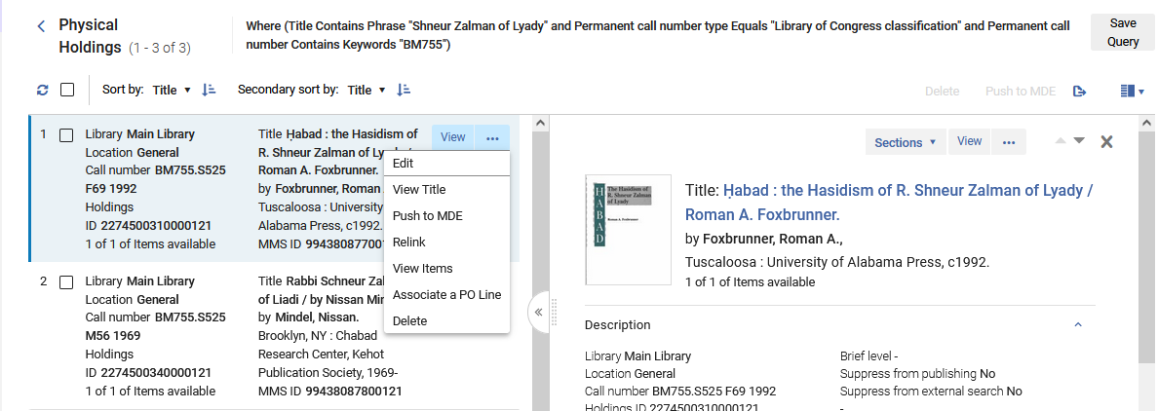
Physical holdings advanced search results
Several actions can also be done on the holdings record in the left pane via the “actions” link (three dots)

Slide 31
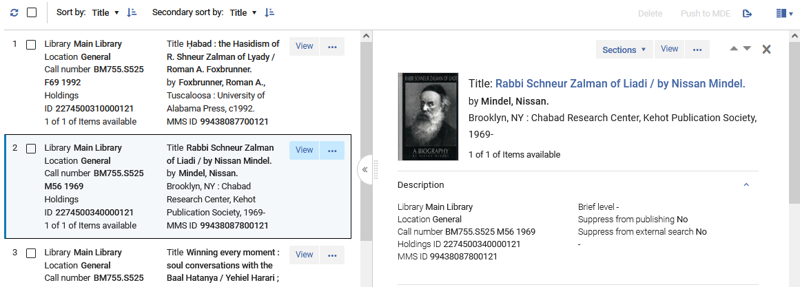
Physical holdings advanced search results
When a holding record is selected on the left the corresponding title appears on the right.

Slide 32
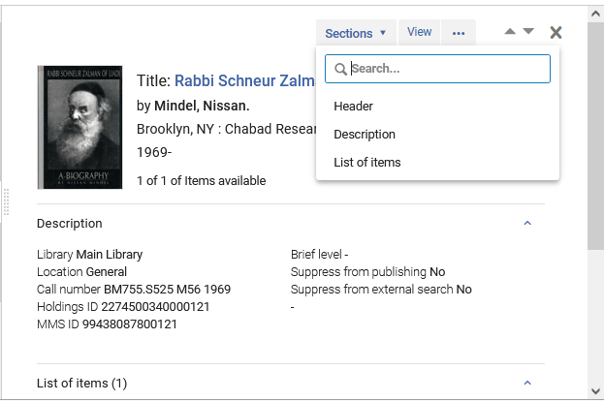
Physical holdings advanced search results
The different parts of the right pane may be viewed by scrolling or by choosing the desired section.

Slide 33
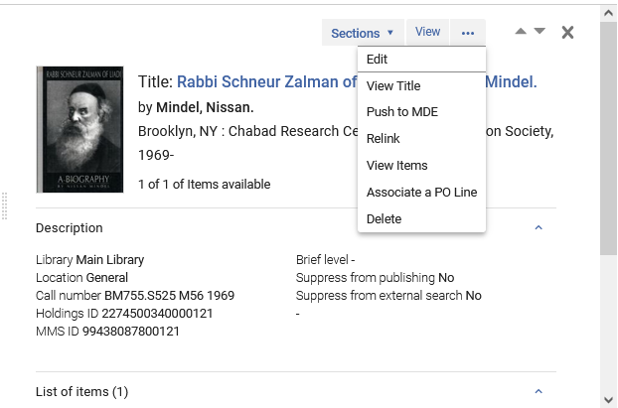
Physical holdings advanced search results
Several actions may also be performed on the record in the right pane.

Slide 34
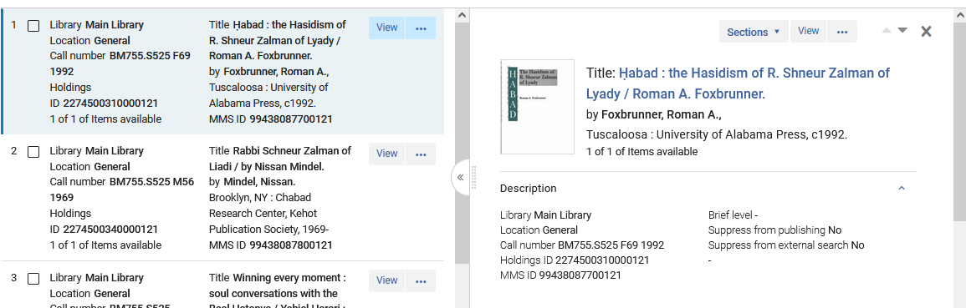
Physical holdings advanced search results
Each user can drag the panes to be small or larger depending on desired view.
We will drag the middle divider to the left.
We will drag the middle divider to the left and then see only the first column of the left pane (we will see the column with the holdings record and not the column with the title)

Slide 35
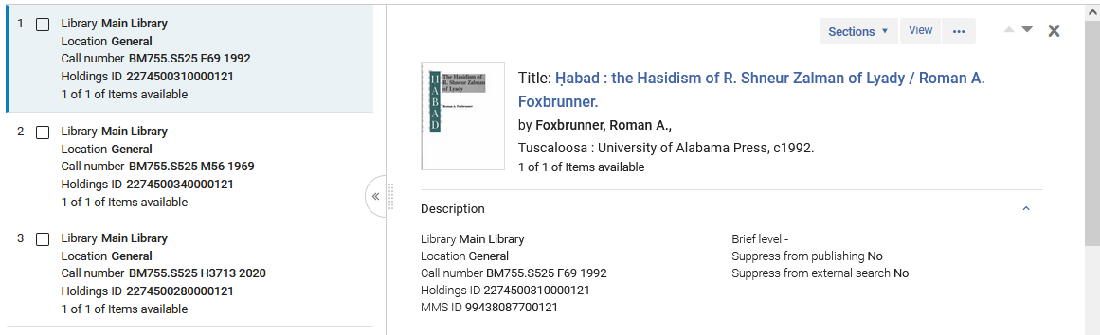
Physical holdings advanced search results
Now the view is as follows:

Slide 36
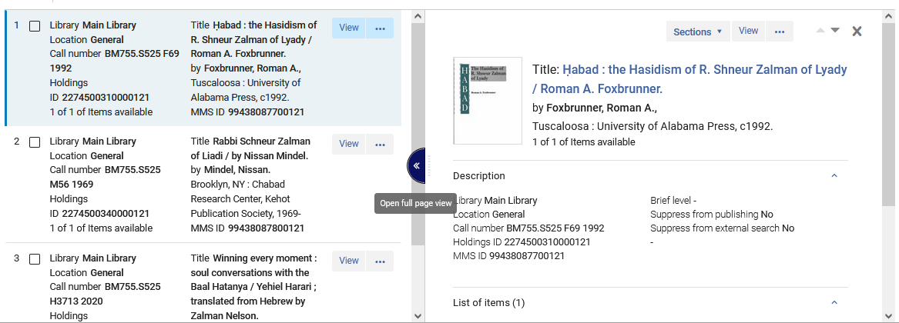
Physical holdings advanced search results
We can also open “full page view” which will show the right pane only, in full view

Slide 37
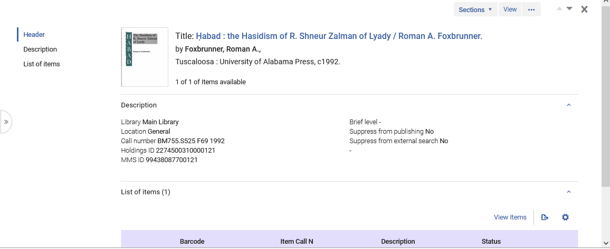
Physical holdings advanced search results
Now the right pane is in full view

